Slide 1
Network Model Automation HP Protect 2015
Joe Partlow, ReliaQuest
September 2015

Slide 2
Who am I?
Joe Partlow (jpartlow@reliaquest.com) – CISO, ReliaQuest
CISSP, CISM, GSEC, CEH, NSA-IAM, ArcSight Certified Partner
Joe has been in the IT and information Security industry for 15+ years and has experience in Operations Management, Information Security, Network Security, Systems Design, Risk Assessment, Database Administration, Network Infrastructure, Web Application Development, Systems Design & Integration and Project Management.
Currently oversees over 50 technical professionals and all technical operations at ReliaQuest including Security Operations Center, Field Engineering, and RQLabs.

Slide 3
Network Model Overview
The Network Model actually consists of two separate models:
Network Model – Made up of Customers, Networks, Zones, Asset Ranges & Assets
Asset Model – Made up of Asset Categories, Locations & Vulnerabilities

Slide 4
Network Model - Details
The Customer setting shows the owner of the event and provides the ability to segregate events by actual customer in a MSSP environment or could be used for an internal business unit or division is you desire to see the events separated.
Still provides value even if only one customer in ArcSight. If populated, adds extra zone info to the event.
The Network designation typically shows the physical network layout driven by IP addresses or ranges. Default is the Local and External IP address spaces.

Slide 5
Network Model – Details Cont.
The Zones typically represents a part of the network or logical section. Ie. Wireless, DMZ, Workstation DHCP, etc.
Static IP address ranges or unique host names
Dynamic DHCP ranges – Uses MAC address or host name
The Asset Range is a range of assets in a contiguous IP block.
Non-significant resources such as workstations are typically added as a range.
Assets are network endpoints that consists of a name, MAC address, IP address, Fully Qualified Host Name and/or External ID (unique ID form separate inventory system)
Significant endpoints such as critical network infrastructure or servers are added as assets.

Slide 6
Network Model – Population
There are multiple ways to populate assets into ArcSight, each with it’s own pros and cons.
Manually - Create the zones, assets and asset ranges yourself. Great quality control until you have thousands of assets on the network.
Network Modeling Wizard – A built-in batch process to import assets, zones, asset ranges from CSV files. Sounds like a good option until you realize you can’t re-run the import as often as you like.
Ok option for a first time population

Slide 7
Network Model – Population Cont.
There are also ways to import on a more regular basis with SmartConnectors.
Asset Import FlexConnector - Create the zones, assets, categories and asset ranges in set CSV format. Seems to be the best option for flexibility and maintaining on regular basis.
Regular SmartConnectors can also create assets if set in the agent.properties file. Usually ends up creating a mess ☹
Vulnerability Scan results – Uses a connector watching the scanner results folder to import based on vulnerability scans from nessus, retina, qualys, etc. Seems to be the most common option since we need the port and vulnerability data anyway. Problem is regularity and timing of scan in large environments.

Slide 8
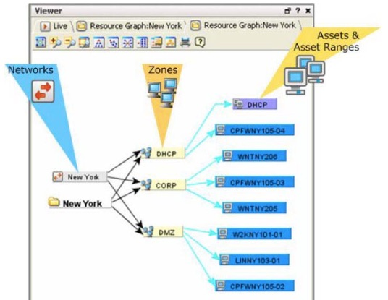
Network Model – Verifying
We have everything imported, how to check it? Right click on the asset, zone or network and select “Graphic View”…

Slide 9
Asset Model - Details
Multiple components exist in the Asset Model as well:
Asset Categories define properties of an asset such as the Operating System, key applications or business functions of the resource. Many built-in ones inside ArcSight used for reporting.
PCI Compliance pack is heavily dependent on correctly categorizing the assets!
Can be tied to Asset Groups, Asset ranges, Zones or individual Assets.
Lots built-in but don’t forget to add ones for your business!

Slide 10
Asset Model – Details Cont.
Locations allow to show the physical location where the IP addresses reside. Uses latitude and longitude
Useful for Google Maps and the couple built-in ArcSight reports
Vulnerability information is critical for accurate event priority and modeling in ArcSight.
Can populate assets in the Network Model
Populates the port information in Categories.
Event priority…

Slide 11
Asset Model - Priority Formula
Ever question how ArcSight comes up with those priority scores? The 4 Main factors are below:
Model Confidence – Has the asset been modeled completely in ESM? Ex. Open ports & vulnerabilities
Relevance – Is the event targeting and open port or known vulnerability?
Severity – Has the asset been attacker or listed as an attacker in the past?
Asset Criticality – How important is the asset? Ex. Very High, High, Medium, Low, Very Low.
*FraudView package can also override defaults by allowing a customized weighting to different scenarios.

Slide 12
The Problem
Most engagement we do have similar problems that contribute to an incomplete or inaccurate Network Model.
No single point of truth for inventory. Multiple inventory systems, excel sheets, Active Directory or some combination of many.
Security team is last to know on infrastructure changes or re-organizations.
Moving target due to mergers or acquisitions.
High turnover or not enough staff to keep up with it.

Slide 13
Let’s Automate!
How does it work? Here are the main elements:
Import the Data – SSIS can import a variety of formats (CSV, XML, Tab delimited, etc.)
Consolidate the data – Staging and Master databases to keep track of potentially multiple sets of inventory.
Automated Categorization – Series of TSQL scripts to update based on import info received (open ports etc.)
Output the Data – SSIS to export a consolidated, master copy of the data for the Flex Asset Connector to pick up.
Web portal for reporting and management.

Slide 14
Demo
Cut to demo…

Slide 15
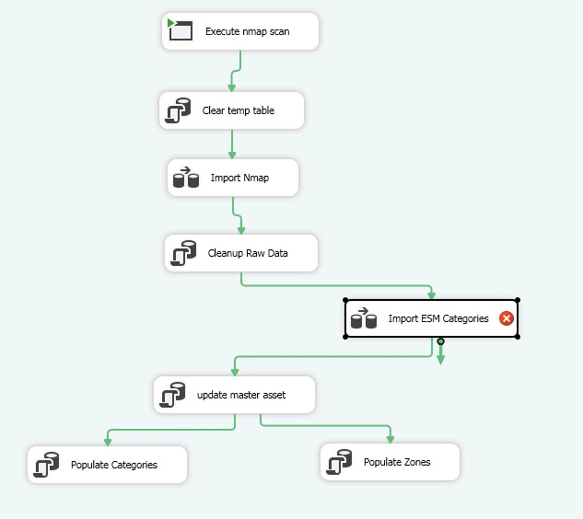
Demo Screen Shots
SSIS Workflow:

Slide 16
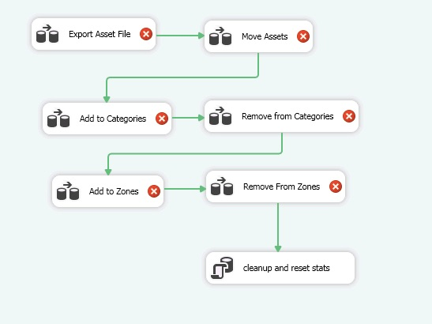
Demo Screen Shots
Export Workflow:

Slide 17
Advanced Methods
For teams with a development resource that could be leveraged, the API provides additional flexibility to report on the model.
Phase 2 of the tool may integrate the API
Unfortunately most teams don’t have the dev resources to create/maintain ☹
Still have the issue to getting the single point of inventory
Seems to have difficulty adding assets, just deleting?

Slide 18
What next?
Tons of great resources out there for best practices on how/when/why to setup the Network Model:
Protect 7/24 has tons of great user submitted suggestions
Past Protect conference presentations
ESM 101 document has a great overview

Slide 19
Thank You Questions?
For more information:
Joe Partlow
Web: reliaquest.com | Twitter: @reliaquest
jpartlow@reliaquest.com

